Slide 1


TON DUC THANG UNIVERSITY
FACULTY OF ELECTRICAL AND ELECTRONICS ENGINEERING
402084 DIGITAL IMAGE PROCESSING
CHAPTER 3: DIGITAL IMAGE COMPRESION
Vu Anh. Le, Phd.

Slide 2
OBJECTIVES
Known why need image compression
Know the block diagram of image compression .
Understand Huffman coding, lossless and lossy coding
Understand JPEG image conpression standard.

Slide 3
CHAPTER 3: Digital image compression
1.1 IMAGE COMPRESSION OVERVIEW
1.2 DITGITAL IMAGE COMPRESSION STEPS
1.3 HUFFMAN CODING
1.4 JPEG STANDARD

Slide 4
IMAGE COMPRESSION OVERVIEW
The size of typical still image (1200x1600)
The size of two hours standard television (720x480) movies

Slide 5
IMAGE COMPRESSION OVERVIEW
Data, Information, and Redundancy
The term data compression refers to the process of reducing the amount of data required to represent a given quantity of information
Data is used to represent Information
Redundancy in data representation of an information provides no relevant information or repeats a stated information

Slide 6
IMAGE COMPRESSION OVERVIEW
Data, Information, and Redundancy
Let n₁ and n₂ denote the number of information carrying units in two data sets that represent the same information
The relative redundancy R_{D} is define as :
where C_{R}, commonly called the compression ratio, is

Slide 7
IMAGE COMPRESSION OVERVIEW
Data, Information, and Redundancy
If n₁ = n_{2 ,} C_{R}=1 and R_{D}=0 no redundancy
If n₁ >> n_{2 ,} C_{R} and R_{D} high redundancy
If n₁ << n_{2 ,} C_{R} and R_{D} undesirable
A compression ration of 10 (10:1) means that the first data set has 10 information carrying units (say, bits) for every 1 unit in the second (compressed) data set.

Slide 8
IMAGE COMPRESSION OVERVIEW
Redundancy in Digital Images Data
Coding redundancy: usually appear as results of the uniform representation of each pixel
Inter-pixel Redundancy : because the adjacent pixels tend to have similarity in practical.
Irrelevant Information: Image contain information which are ignored by the human visual system.

Slide 9
IMAGE COMPRESSION OVERVIEW
Coding Redundancy
Recall from the histogram calculations
The average code bits length assigned to the gray level values.
The length of the code should be inverse proportional to its probability (occurrence).

Slide 10
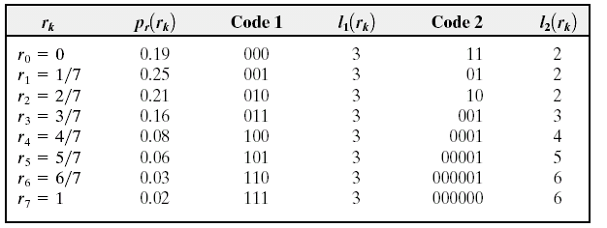
IMAGE COMPRESSION OVERVIEW
Coding Redundancy
Example

Slide 11
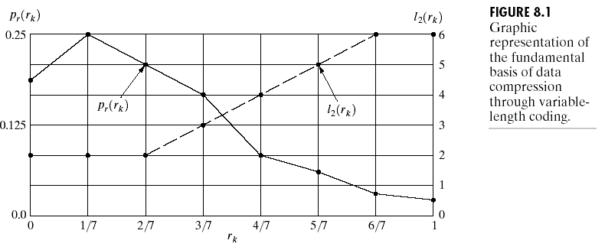
IMAGE COMPRESSION OVERVIEW
Coding Redundancy
Variable-Length
Coding

Slide 12
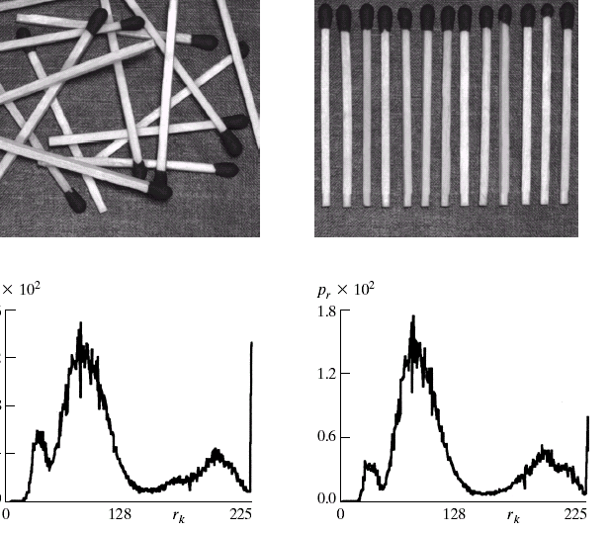
IMAGE COMPRESSION OVERVIEW
Inter-pixel Redundancy
Internal Correlation between the pixel
A pixel can be predicted from the values of its neighbors.
To reduce 2D array is transformed (mapped) into more efficient format (Frequency Domain etc.)

Slide 13
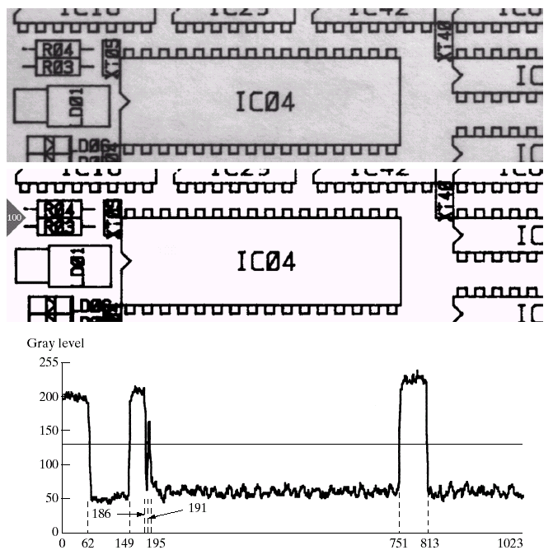
IMAGE COMPRESSION OVERVIEW
Run-Length Encoding
Example of Inter-pixel Redundancy removal

Slide 14
IMAGE COMPRESSION OVERVIEW
Irrelevant information and Psycho-Visual Redundancy Internal Correlation between the pixel
The perceived intensity of the eye is limited
Certain information has less relative importance that other information in normal visual processing
In general, observer searches for distinguishing features such as edges and textural regions

Slide 15
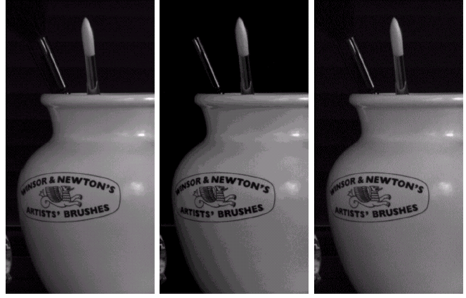
IMAGE COMPRESSION OVERVIEW
The human visual system is more sensitive to edges
Middle Picture:
Uniform quantization from 256 to
16 gray levels
C_{R}= 2
Right picture:
Improved gray level quantization
(IGS)
CR= 2
The perceived intensity of the eye is limited
Certain information has less relative importance that other information in normal visual processing
In general, observer searches for distinguishing features such as edges and textural regions

Slide 16
IMAGE COMPRESSION OVERVIEW
Measuring Information
A random even E that occurs with probability P(E) is said to contain I(E) information where I(E) is defined as

Slide 17
IMAGE COMPRESSION OVERVIEW
Measuring Information
For a source of events a0 , a1 ,a2 , .., ak with associated probability
For image, we use the normalized histogram to generate the source probability, which leads to the entropy

Slide 18
IMAGE COMPRESSION OVERVIEW
Fidelity Criteria-Objective Fidelity Criteria

Slide 19
IMAGE COMPRESSION OVERVIEW
Fidelity Criteria-Objective Fidelity Criteria

Slide 20
IMAGE COMPRESSION OVERVIEW
Fidelity Criteria-Objective Fidelity Criteria

Slide 21
CHAPTER 3: Digital image compression
1.1 IMAGE COMPRESSION OVERVIEW
1.2 DITGITAL IMAGE COMPRESSION STEPS
1.3 HUFFMAN CODING
1.4 JPEG STANDARD

Slide 22
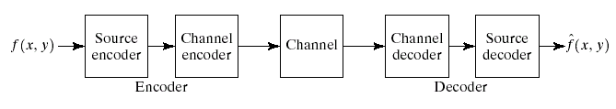
Digital image compression steps
Compression Model
The source encoder is responsible for removing redundancy (coding, inter-pixel, psycho-visual)
The channel encoder ensures robustness against channel noise

Slide 23
Digital image compression steps
Compression Types
Compression
Error-Free Compression
(Loss-less)
Lossy Compression

Slide 24
Digital image compression steps
Error-Free Compression
Some applications require no error in compression (medical, business documents, etc..)
C_{R}=2 to 10 can be expected.
Make use of coding redundancy and inter-pixel redundancy.
Ex: Huffman codes, LZW, Arithmetic coding, 1D and 2D run-length encoding, Loss-less Predictive Coding, and Bit-Plane Coding.

Slide 25
Digital image compression steps
Image/Video Compression Standards

Slide 26
Digital image compression steps
Huffman coding
An entropy encoding algorithm used for lossless data compression.
The term refers to the use of a variable length code table for encoding a source symbol
The variable-length code table has been derived in a particular way based on the estimated probability of occurrence for each possible value of the source symbol

Slide 27
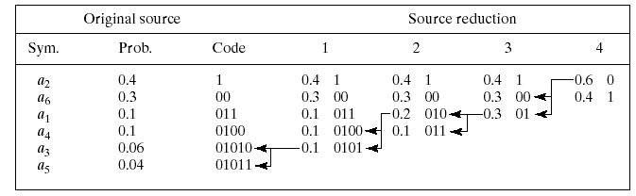
Digital image compression steps
Huffman coding

Slide 28
Digital image compression steps
Fixed Length: LZW
Error Free Compression Technique
Remove Inter-pixel redundancy
Requires no priori knowledge of probability distribution of pixels
Assigns fixed length code words to variable length sequences
Included in GIF and TIFF and PDF file formats

Slide 29
Digital image compression steps
Fixed Length: LZW Coding Technique
A codebook or a dictionary has to be constructed
For an 8-bit monochrome image, the first 256 entries are assigned to the gray levels 0,1,2,..,255.
As the encoder examines image pixels, gray level sequences that are not in the dictionary are assigned to a new entry.

Slide 30
Digital image compression steps
Fixed Length: LZW
Example
Consider the following 4 x 4 8 bit image
39 39 126 126
39 39 126 126
39 39 126 126
39 39 126 126
Dictionary Location Entry
0 0
1 1
. .
255 255
256 -
511 -
Initial Dictionary

Slide 31
Digital image compression steps
Fixed Length: LZW
39 39 126 126
39 39 126 126
39 39 126 126
39 39 126 126
Is 39 in the dictionary……..Yes
What about 39-39………….No
Then add 39-39 in entry 256
And output the last recognized symbol…39x
Dictionary Location Entry
0 0
1 1
. .
255 255
256 -
511 -
39-39

Slide 32
Digital image compression steps
Fixed Length: LZW
Code the following image using LZW codes
39 39 126 126
39 39 126 126
39 39 126 126
39 39 126 126
* How can we decode the compressed sequence to obtain the original image ?

Slide 33
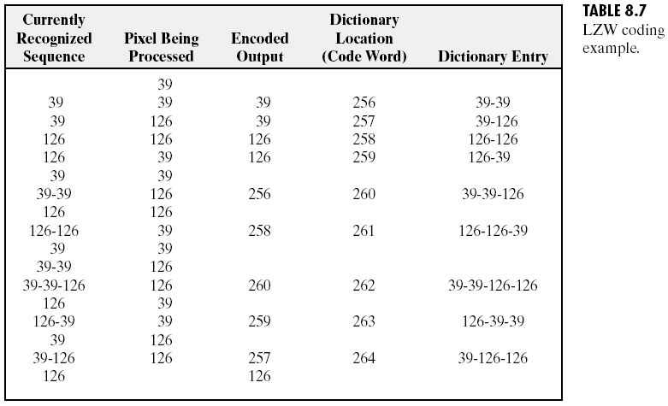
Digital image compression steps
Fixed Length: LZW

Slide 34
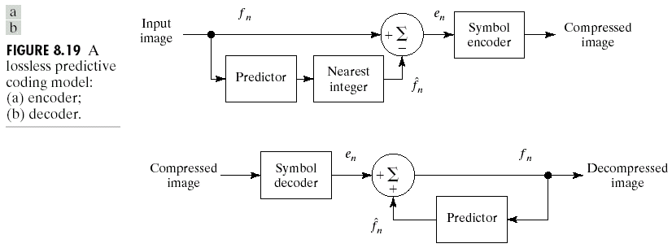
Digital image compression steps
Loss-less Predictive Encoding

Slide 35
Digital image compression steps
Loss-less Predictive Encoding
For each pixel a predictor (one of 7 possible) is used that best predicts the value contained in the pixel as a combination of up to 3 neighboring pixels.
The difference between the predicted value and the actual value (X) contained in the pixel is used as the predictive difference to represent the pixel.
The predictor along with the predictive difference are encoded as the pixel’s content.
The series of pixel values are encoded using Huffman coding

Slide 36
Digital image compression steps
Loss-less Predictive Encoding
Predictor | Prediction
P1 | A
P2 | B
P3 | C
P4 | A+B-C
P5 | A + (B-C)/2
P6 | B + (A-C)/2
P7 | (A+B)/2
Notes:
The very first pixel in location (0, 0) will always use itself.
Pixels at the first row always use P1,
Pixels at the first column always use P2.
The best (of the 7) predictions is always chosen for any pixel.
C
B
A
X

Slide 37
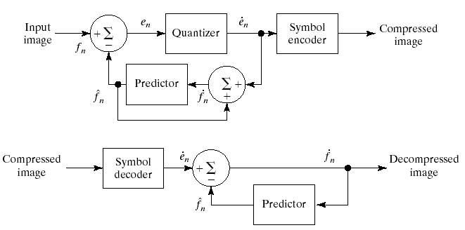
Digital image compression steps
Lossy Compression
Quantizer

Slide 38
Digital image compression steps
Transform Coding
Decorrelate pixels and pack as much information into small number of transform coefficients.
A reversible linear transform (such as Fourier Transform) is used to map the image into a set of transform coefficients
These coefficients are then quantized and coded.
Compression is achieved during quantization not during the transform step

Slide 39
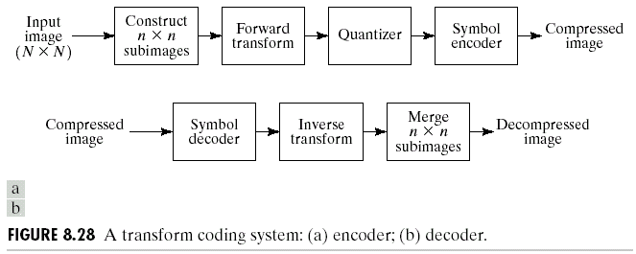
Digital image compression steps
Transform Coding block diagram

Slide 40
Digital image compression steps
2D Transforms
Energy packing: 2D transforms pack most of the energy into small number of coefficients located
at the upper left corner of the 2D array
Energy
Packing

Slide 41
Digital image compression steps
2D Transforms
Consider an image f(x,y) of size N x N
Forward transform
g(x,y,u,v) is the forward transformation kernel or basis functions

Slide 42
Digital image compression steps
2D Transforms
Consider an image f(x,y) of size N x N
Inverse transform
h(x,y,u,v) is the inverse transformation kernel or basis functions

Slide 43
Digital image compression steps
Discrete Cosine Transform
One of the most frequently used transformations for image compression is the DCT.
Consider an image f(x,y) of size N x N

Slide 44
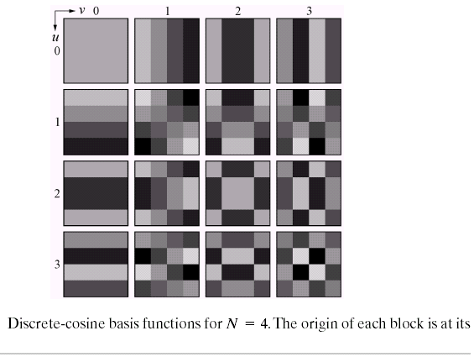
Digital image compression steps
Discrete Cosine Transform
Consider an image f(x,y) of size N x N
Coefficients of DCT: note the DC and AC components of difference frequencies

Slide 45
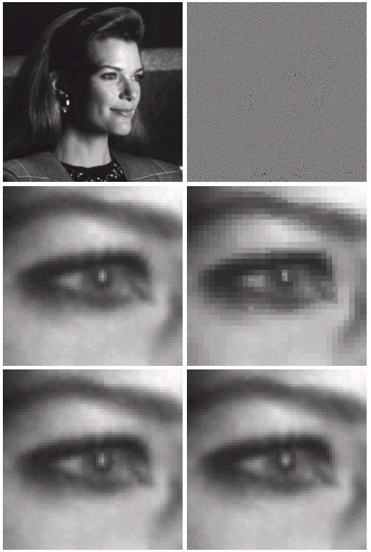
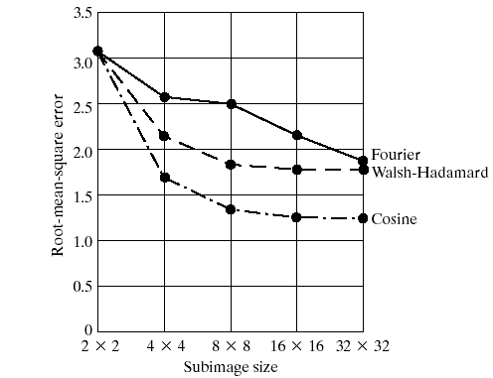
Digital image compression steps
Discrete Cosine Transform
Effect of Window Size

Slide 46
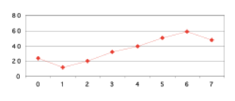
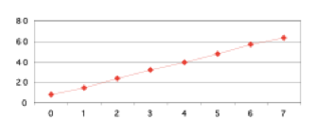
Digital image compression steps
Discrete Cosine Transform
Compare DCT an FFT
DCT
FFT
100 | -52 | 0 | -5 | 0 | -2 | 0 | 0.4
36 | 10 | 10 | 6 | 6 | 4 | 4 | 4
100 | -52 | 0 | -5 | 0 | -2 | 0 | 0.4
36 | 10 | 10 | 6 | 6 | 4 | 4 | 4
Inverse DCT
Inverse FFT
8 | 15 | 24 | 32 | 40 | 48 | 57 | 63
24 | 12 | 20 | 32 | 40 | 51 | 59 | 48
46

Slide 47
Digital image compression steps
Quantization: reduce number of bits per sample
Quantization error is the main source of the Lossy Compression.
Uniform Quantization: q(u,v) is a constant
Non-uniform Quantization -- Quantization Tables
Eye is most sensitive to low frequencies (upper left corner in frequency matrix)
less sensitive to high frequencies (lower right corner)
Quantizer

Slide 48
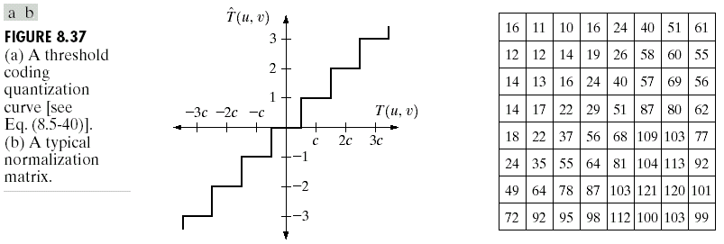
Digital image compression steps
Quantization: reduce number of bits per sample
Each transformed coefficient is quantized
Z(u,v) quantization coefficients
Quantizer

Slide 49
Digital image compression steps
Bit allocation and Zig Zag Ordering
to group low frequency coefficients in top of vector and high frequency coefficients at the bottom
Maps 8 x 8 matrix to a 1 x 64 vector
8x8
. . .
1x64

Slide 50
Digital image compression steps
DPCM on DC Components
The DC component often close to that in the previous block
Differential Pulse Code Modulation (DPCM): Remember, smaller number -> fewer bits
45
45
1x64
1x64
54
9
1x64
1x64
48
-6
1x64
1x64

Slide 51
Digital image compression steps
RLE on AC Components
The 1x64 vectors have a lot of zeros in them, more so towards the end of the vector
Encode a series of 0s as a (skip, value) pair
. . .
0
0
0
0
0
1
1
0
0
0
0
0
0
0
0
2
. . .
1x64

Slide 52
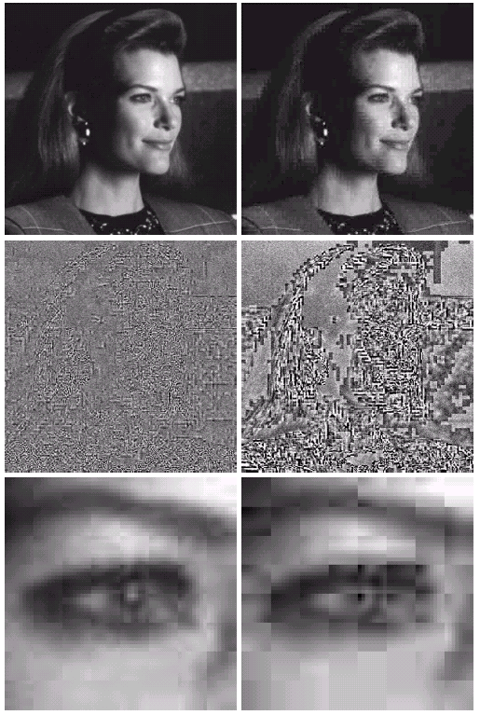
Digital image compression steps
DCT and Quantization
Right Column

Slide 53
CHAPTER 3: Digital image compression
1.1 IMAGE COMPRESSION OVERVIEW
1.2 DITGITAL IMAGE COMPRESSION STEPS
1.3 HUFFMAN CODING
1.4 JPEG STANDARD

Slide 54
HUFFMAN CODING
Coding Redundancy
Example

Slide 55
HUFFMAN CODING
Coding Redundancy
Variable-Length
Coding

Slide 56
CHAPTER 3: Digital image compression
1.1 IMAGE COMPRESSION OVERVIEW
1.2 DITGITAL IMAGE COMPRESSION STEPS
1.3 HUFFMAN CODING
1.4 JPEG STANDARD

Slide 57
JPEG STANDARD
JPEG Compression
DCT
Quantization
Zig-Zag Scan
RLE and DPCM
Entropy Coding

Slide 58
JPEG STANDARD
Block diagram
C_{b}
f(i, j)
F(u, v)
Fq(u, v)
Y
DCT
Quantization
C_{r}
8 x 8
8 x 8
Quant…
Tables
Coding
Tables
Zig Zag
Scan
Header
Tables
Data
Entropy
Coding
DPCM
RLC
58

Slide 59
JPEG STANDARD
Steps Involved:
Discrete Cosine Transform of each 8x8 pixel array f(x,y) →T F(u,v)
Quantization using a table or using a constant
Zig-Zag scan to exploit redundancy
Differential Pulse Code Modulation(DPCM) on the DC component and Run length Coding of the AC components
Entropy coding (Huffman) of the final output
59

Slide 60
SUMMARY
This chapter we have learnt:
The need image compression
block diagram of image compression .
Huffman coding, lossless and lossy coding
JPEG image conpression standard.

Slide 61
HOMEWORK
Review the Chapter 3
Read chapter 4 (pp. 547-564 )
Solve the exercise: 3.1, 3.2, 3.4, 3.5, 3.7, 3.11, 3.12, 3.15, 3.20, 3.25.

